Slide 1
Day 12
Paths satisfying end point constraints

Slide 2
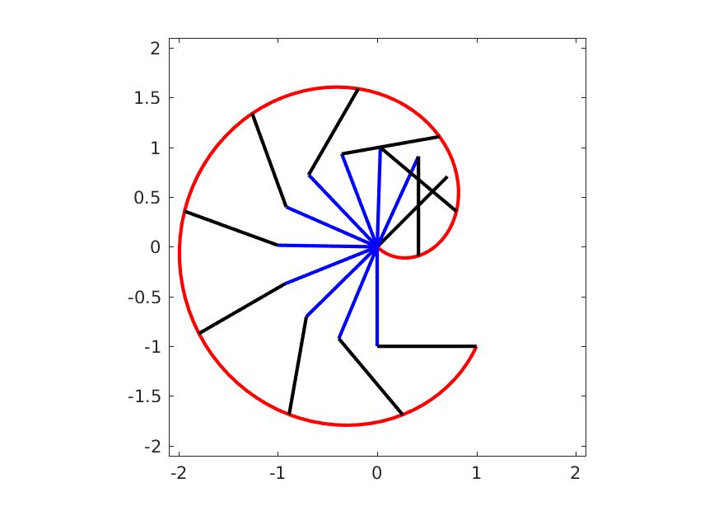
Joint-Space Path
a joint-space path is computed considering the joint variables
link 1
link 2
end effector path

Slide 3
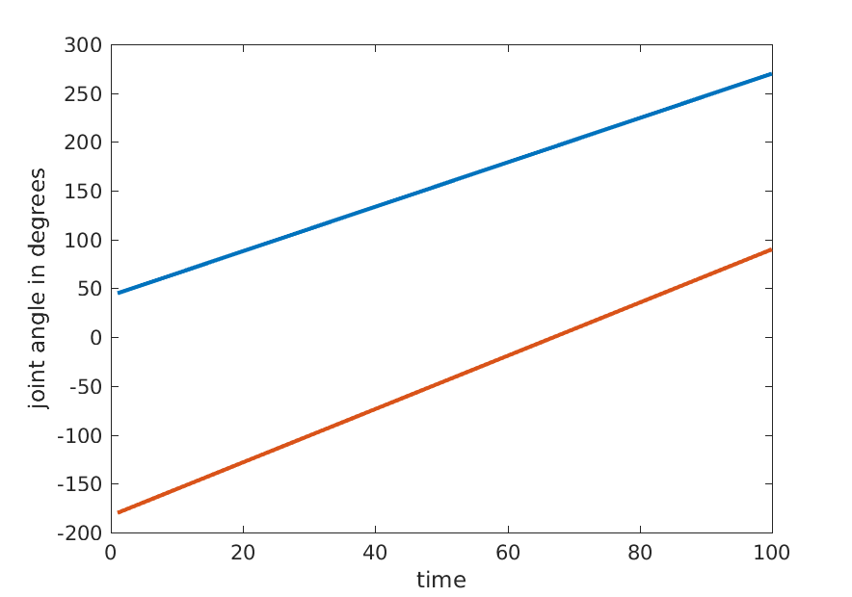
Joint-Space Path Joint Angles
linear joint-space path
link 1
link 2

Slide 4
Constraints
in the previous example we had two constraints for joint 1:
${}_{}^{0}{θ_{1}=60}$
${}_{}^{f}{θ_{1}=270}$
the simplest path satisfying these constraints is the straight line path
if we add more constraints then a straight line path may not be able to satisfy all of the constraints

Slide 5
Velocity constraints
a common constraint is that the robot starts from a stationary position and stops at a stationary positions
in other words, the joint velocities are zero at the start and end of the movement
${}_{}^{0}{\left(\frac{{dθ}_{1}}{dt}\right)}={}_{}^{0}{{\dot{θ}}_{1}}=0$
${}_{}^{f}{\left(\frac{{dθ}_{1}}{dt}\right)}={}_{}^{f}{{\dot{θ}}_{1}}=0$
more generally, we might require non-zero velocities
${}_{}^{0}{\left(\frac{{dθ}_{1}}{dt}\right)}={}_{}^{0}{{\dot{θ}}_{1}}={}_{}^{0}v$
${}_{}^{f}{\left(\frac{{dθ}_{1}}{dt}\right)}={}_{}^{f}{{\dot{θ}}_{1}}={}_{}^{f}v$

Slide 6
Acceleration constraints
for smooth motion, we might require that the acceleration at the start and end of the motion be zero
${}_{}^{0}{\left(\frac{{d^{2}θ}_{1}}{dt^{2}}\right)}={}_{}^{0}{{\ddot{θ}}_{1}}=0$
${}_{}^{f}{\left(\frac{{d^{2}θ}_{1}}{dt^{2}}\right)}={}_{}^{f}{{\ddot{θ}}_{1}}=0$
more generally, we might require non-zero accelerations
${}_{}^{0}{\left(\frac{{d^{2}θ}_{1}}{dt^{2}}\right)}={}_{}^{0}{{\ddot{θ}}_{1}}={}_{}^{0}α$
${}_{}^{f}{\left(\frac{{d^{2}θ}_{1}}{dt^{2}}\right)}={}_{}^{f}{{\ddot{θ}}_{1}}={}_{}^{f}α$

Slide 7
Satisfying the constraints
given some set of constraints on a joint variable $q$ our goal is to find $q\left(t\right)$ that satisfies the constraints
there are an infinite number of choices for $q\left(t\right)$
it is common to choose “simple” functions to represent $q\left(t\right)$

Slide 8
Satisfying the constraints with polynomials
suppose that we choose $q\left(t\right)$ to be a polynomial
if we have $n$ constraints then we require a polynomial with $n$ coefficients that can be chosen to satisfy the constraints
in other words, we require a polynomial of degree $\left(n−1\right)$

Slide 9
Satisfying the constraints with polynomials
suppose that we have joint value and joint velocity constraints
$q\left(t_{0}\right)=q_{0}$
$q\left(t_{f}\right)=q_{f}$
$\dot{q}\left(t_{0}\right)=v_{0}$
$\dot{q}\left(t_{f}\right)=v_{f}$
we require a polynomial of degree 3 to represent $q\left(t\right)$
$q\left(t\right)=a+bt+ct^{2}+dt^{3}$
the derivative of $q\left(t\right)$ is easy to compute
$\dot{q}\left(t\right)=b+2ct+3dt^{2}$

Slide 10
Satisfying the constraints with polynomials
equating $q\left(t\right)$ and $\dot{q}\left(t\right)$ to each of the constraints yields:
$q\left(t_{0}\right)=q_{0}=a+bt_{0}+ct_{0}^{2}+dt_{0}^{3}$
$q\left(t_{f}\right)=q_{f}=a+bt_{f}+ct_{f}^{2}+dt_{f}^{3}$
$\dot{q}\left(t_{0}\right)=v_{0}=b+2ct_{0}+3dt_{0}^{2}$
$\dot{q}\left(t_{f}\right)=v_{f}=b+2ct_{f}+3dt_{f}^{2}$
which is a linear system of 4 equations with 4 unknowns ($a, b, c, d)$

Slide 11
Example
consider the following constraints where the robot is stationary at the start and end of the movement
$q\left(t_{0}\right)=θ\left(0\right)=10$
$q\left(t_{f}\right)=θ\left(3\right)=80$
$\dot{q}\left(t_{0}\right)=\dot{θ}\left(0\right)=0$
$\dot{q}\left(t_{f}\right)=\dot{θ}\left(3\right)=0$

Slide 12
Example: Joint angle
$$θ\left(3\right)=80$$
cubic
$$θ\left(0\right)=10$$

Slide 13
Example: Joint velocity
quadratic
$$\dot{θ}\left(0\right)=0$$
$$\dot{θ}\left(3\right)=0$$

Slide 14
Example: Joint acceleration
linear

Slide 15
Satisfying the constraints with polynomials
suppose that we have joint value, joint velocity, and joint acceleration constraints
$q\left(t_{0}\right)=q_{0}$
$q\left(t_{f}\right)=q_{f}$
$\dot{q}\left(t_{0}\right)=v_{0}$
$\dot{q}\left(t_{f}\right)=v_{f}$
$\ddot{q}\left(t_{0}\right)=α_{0}$
$\ddot{q}\left(t_{f}\right)=α_{f}$

Slide 16
Satisfying the constraints with polynomials
we require a polynomial of degree 5 to represent $q\left(t\right)$
$q\left(t\right)=a+bt+ct^{2}+dt^{3}+et^{4}+ft^{5}$
the derivatives of $q\left(t\right)$ are easy to compute
$\dot{q}\left(t\right)=b+2ct+3dt^{2}+4et^{3}+5ft^{4}$
$\ddot{q}\left(t\right)=2c+6dt+12et^{2}+20ft^{3}$

Slide 17
Satisfying the constraints with polynomials
equating $q\left(t\right)$, $\dot{q}\left(t\right)$, and $\ddot{q}\left(t\right)$ to each of the constraints yields:
$q\left(t_{0}\right)=q_{0}=a+bt_{0}+ct_{0}^{2}+dt_{0}^{3}$
$q\left(t_{f}\right)=q_{f}=a+bt_{f}+ct_{f}^{2}+dt_{f}^{3}$
$\dot{q}\left(t_{0}\right)=v_{0}=b+2ct_{0}+3dt_{0}^{2}$
$\dot{q}\left(t_{f}\right)=v_{f}=b+2ct_{f}+3dt_{f}^{2}$
$\ddot{q}\left(t_{0}\right)=α_{0}=2c+6dt_{0}+12et_{0}^{2}+20ft_{0}^{3}$
$\ddot{q}\left(t_{f}\right)=α_{f}=2c+6dt_{f}+12et_{f}^{2}+20ft_{f}^{3}$
which is a linear system of 6 equations with 6 unknowns ($a, b, c, d,e,f)$

Slide 18
Example
consider the following constraints where the robot is stationary at the start and end of the movement, and the joint accelerations are zero at the start and end of the movement
$q\left(t_{0}\right)=θ\left(0\right)=10$
$q\left(t_{f}\right)=θ\left(3\right)=80$
$\dot{q}\left(t_{0}\right)=\dot{θ}\left(0\right)=0$
$\dot{q}\left(t_{f}\right)=\dot{θ}\left(3\right)=0$
$\ddot{q}\left(t_{0}\right)=\ddot{θ}\left(0\right)=0$
$\ddot{q}\left(t_{f}\right)=\ddot{θ}\left(3\right)=0$

Slide 19
Example: Joint angle
$$θ\left(3\right)=80$$
quintic
$$θ\left(0\right)=10$$

Slide 20
Example: Joint velocity
quartic
$$\dot{θ}\left(0\right)=0$$
$$\dot{θ}\left(3\right)=0$$

Slide 21
Example: Joint acceleration
cubic
$$\ddot{θ}\left(0\right)=0$$
$$\ddot{θ}\left(3\right)=0$$

